Slide 1
State of Charge and State of Health Estimation of Li-ion Battery
Junzhe Shi
Franklin Zhao
Ruitong Zhu
Xin Peng
CE 295
Team 17
Prof. Scott Maura

Slide 2
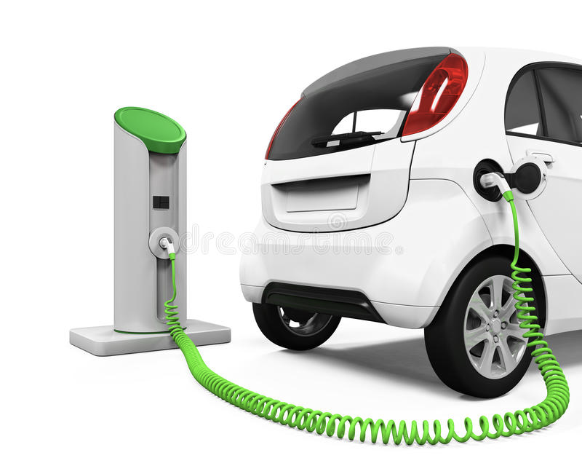
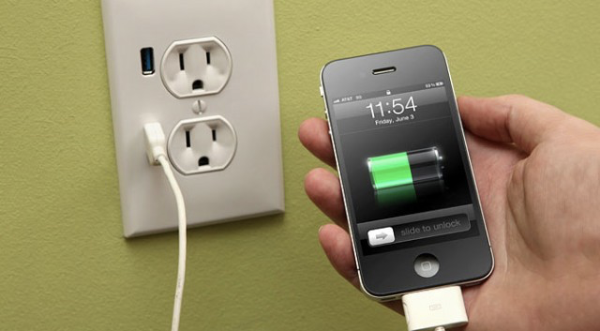


Background

Slide 3
Li-ion battery
Highest possible cell potential.
High gravimetric and volumetric capacity and power density.
Monovalence cation avoids additionally charging.

Slide 4
Motivation
Complex electrochemical reactions and immeasurable internal states cause serious safety and aging concerns for battery charging.
The boom in relevant industry like electrics vehicle has created a demand for charging.
A long-desired yet challenging goal for the identification of battery operation and aging.

Slide 5
Problem Statement
Problem: Observing SOC and SOH of Li-ion battery
First step: Identifying a coupled electro-thermal-aging model
Second step: Designing a robust observer for dynamic battery charging

Slide 6
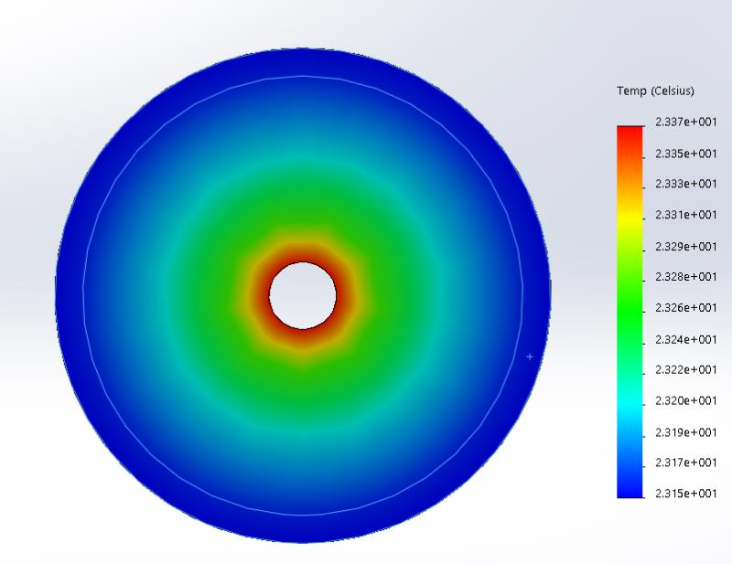
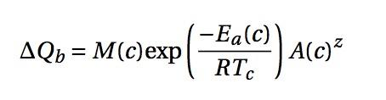
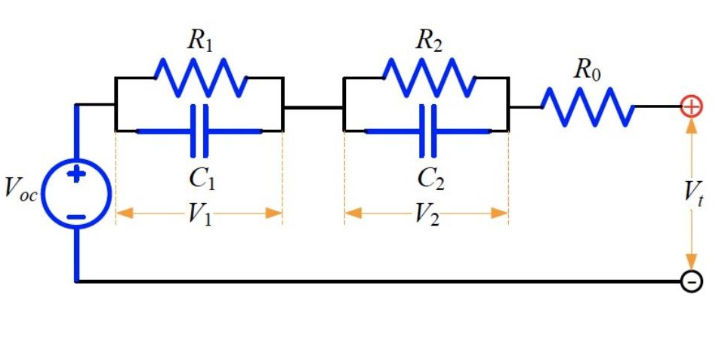

Literature Review
Electrical Model
Thermal Model
Aging Model

Slide 7
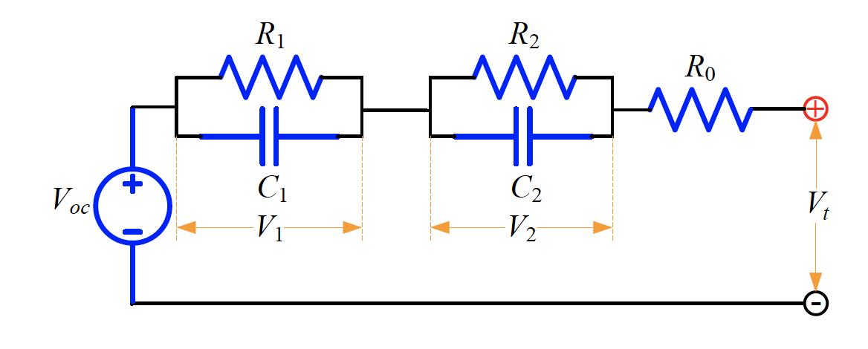
Model
A two RC pair electrical model
Perez, H. E., Hu, X., Dey, S., & Moura, S. J. (2017). Optimal charging of li-ion batteries with coupled electro-thermal-aging dynamics. IEEE Transactions on Vehicular Technology, 66(9), 7761-7770.

Slide 8
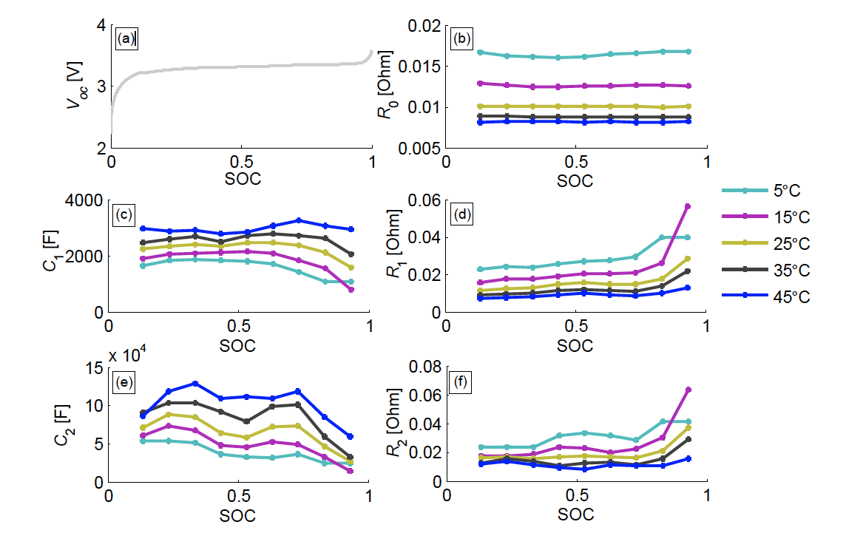
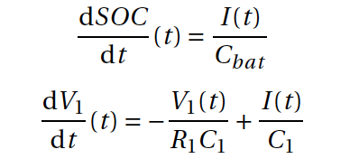
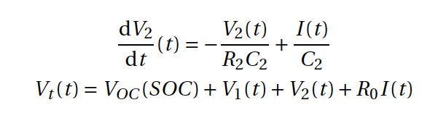
Model
Perez, H. E., Hu, X., Dey, S., & Moura, S. J. (2017). Optimal charging of li-ion batteries with coupled electro-thermal-aging dynamics. IEEE Transactions on Vehicular Technology, 66(9), 7761-7770.

Slide 9
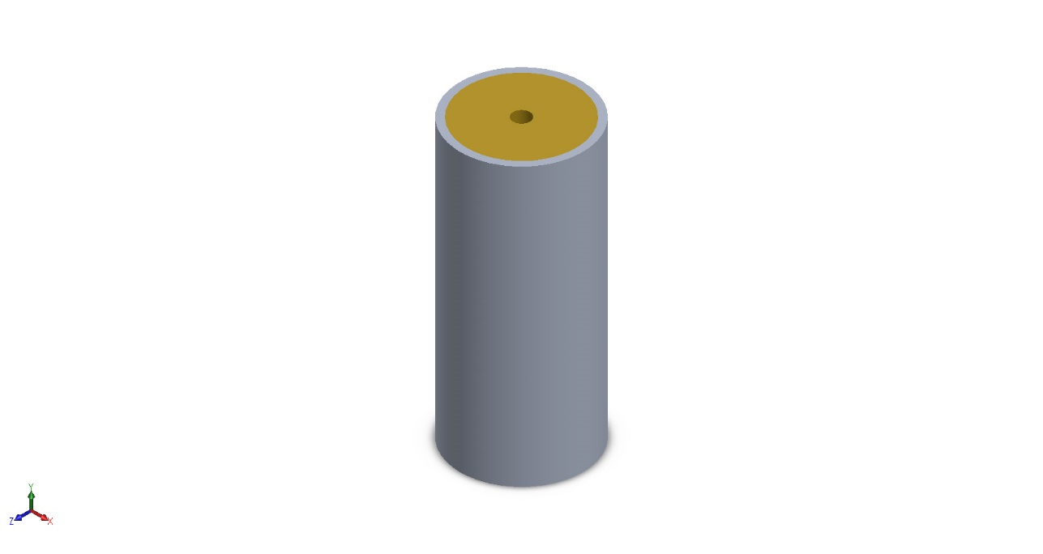
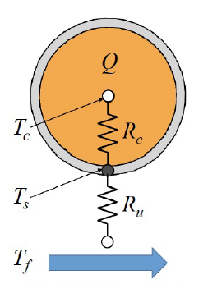
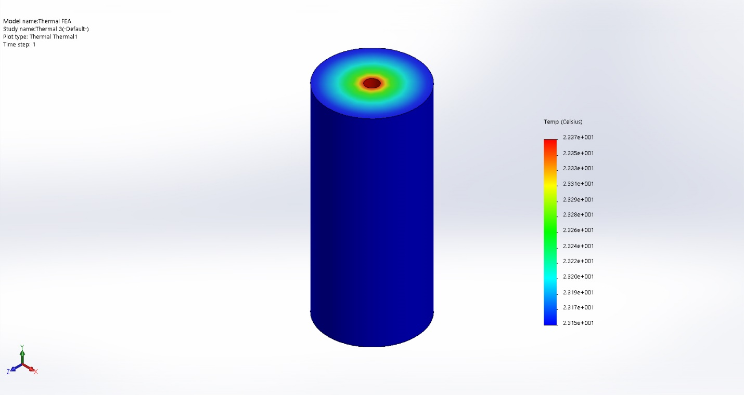
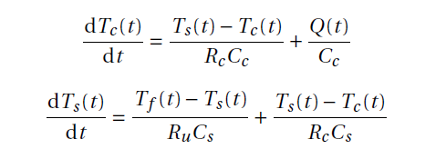
Thermal Models
Core
Surface
A two-state thermal model

Slide 10
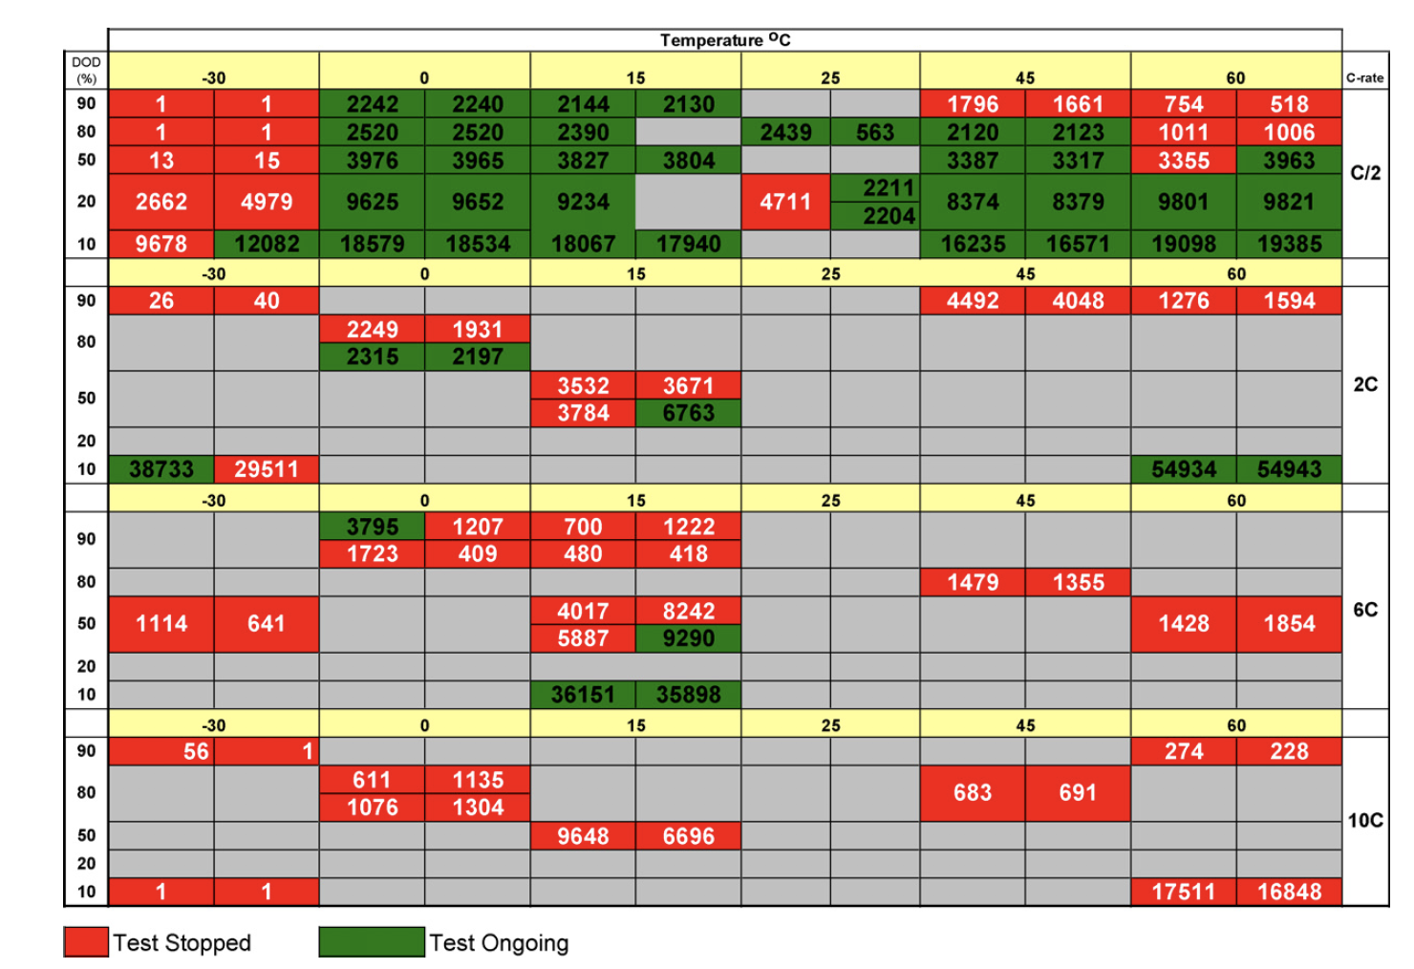
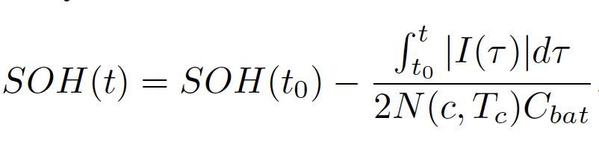
Model
A semi-empirical aging model
Taking a capacity loss of 20% as the end-of-life (EOL)
Wang, John, et al. “Cycle-life model for graphite-LiFePO4 cells." Journal of Power Sources 196.8 (2011): 3942-3948.

Slide 11
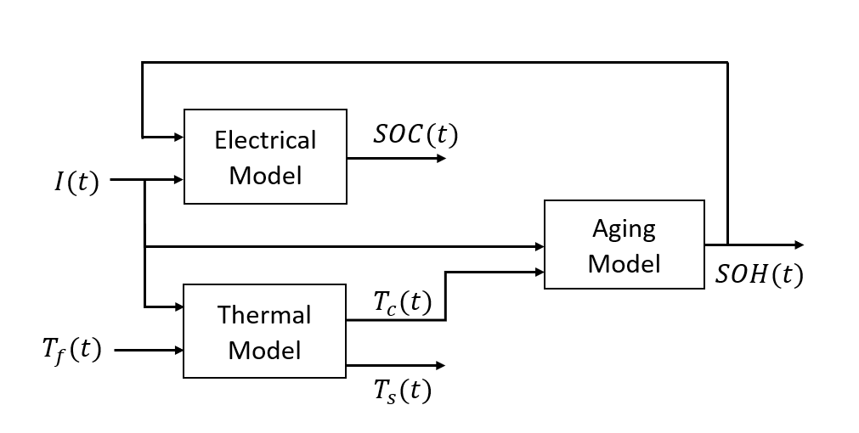
Model
Coupled Dynamics

Slide 12
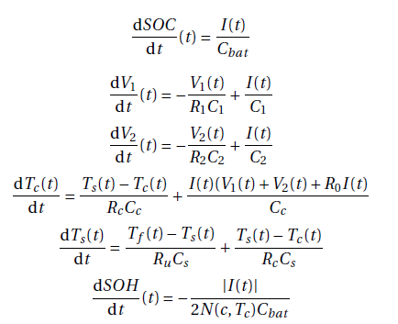
Model
State Estimation
State Variables:
SOC(t), V₁(t), V₂(t), T_{c}(t), T_{s}(t), SOH(t)
Controllable Input:
I(t)
Uncontrollable Input:
T_{f}(t)
Measurable Output:
V_{t}(t), T_{s}(t)

Slide 13

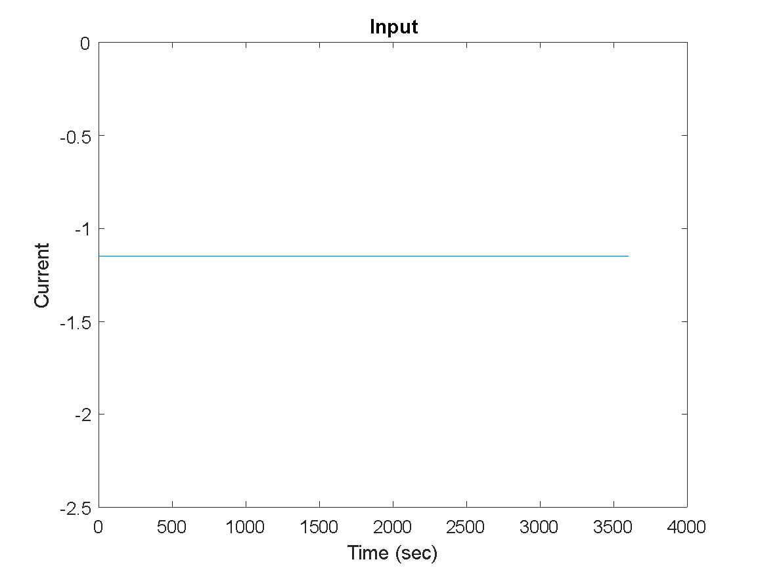
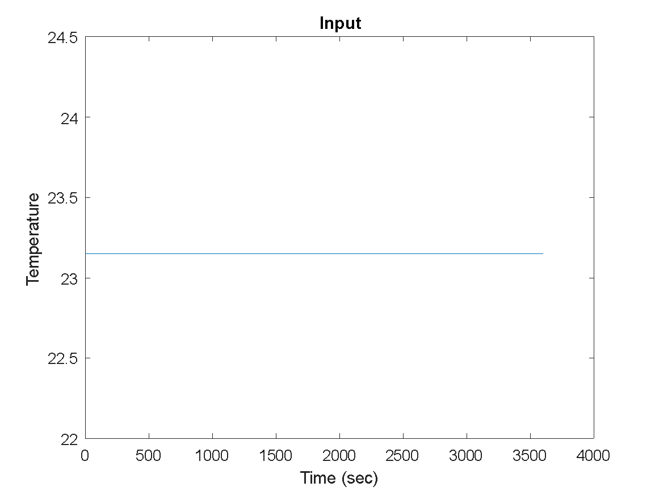
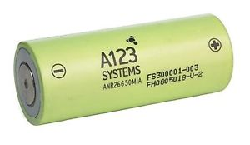
Simulation: Input of the system
Charging Rate: 0.5C
The simulation is based on a 2.3Ah A123 26650 LiFePO4 battery, with simulation duration to be 1 hours (3600s) in total.
Notes:
Our simulation is based on an A123 Li-ion battery. In the 1 hours of simulation, the controllable input is charging rate which is a constant value 0.5 C. The uncontrollable input, ambient temperature, is also constant value which is 23.15 degree celsius.

Slide 14
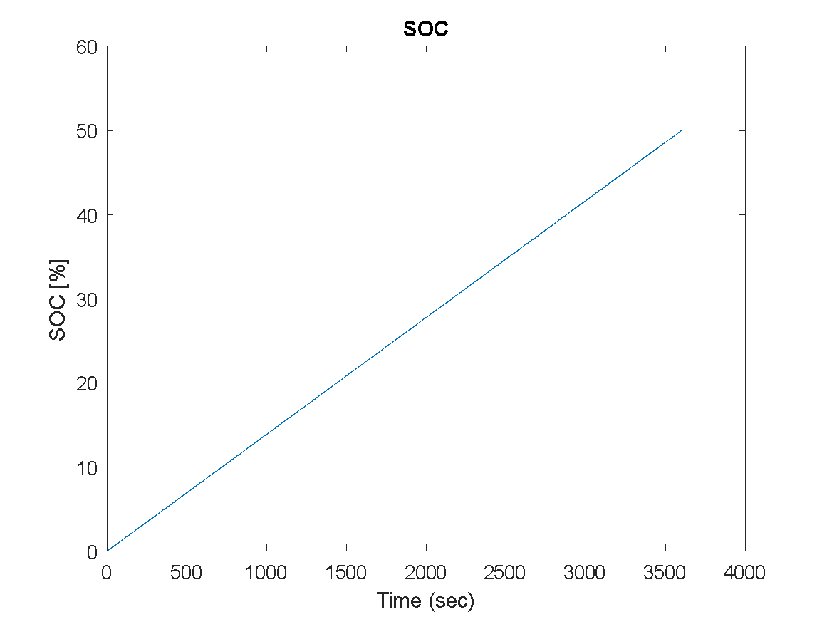
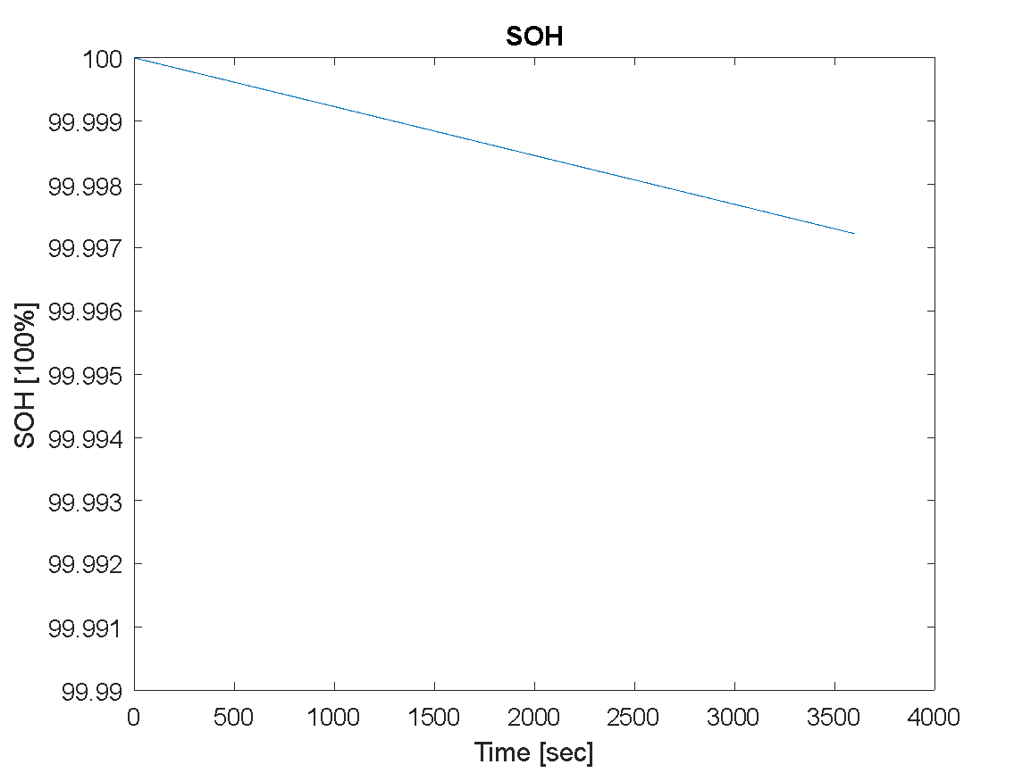
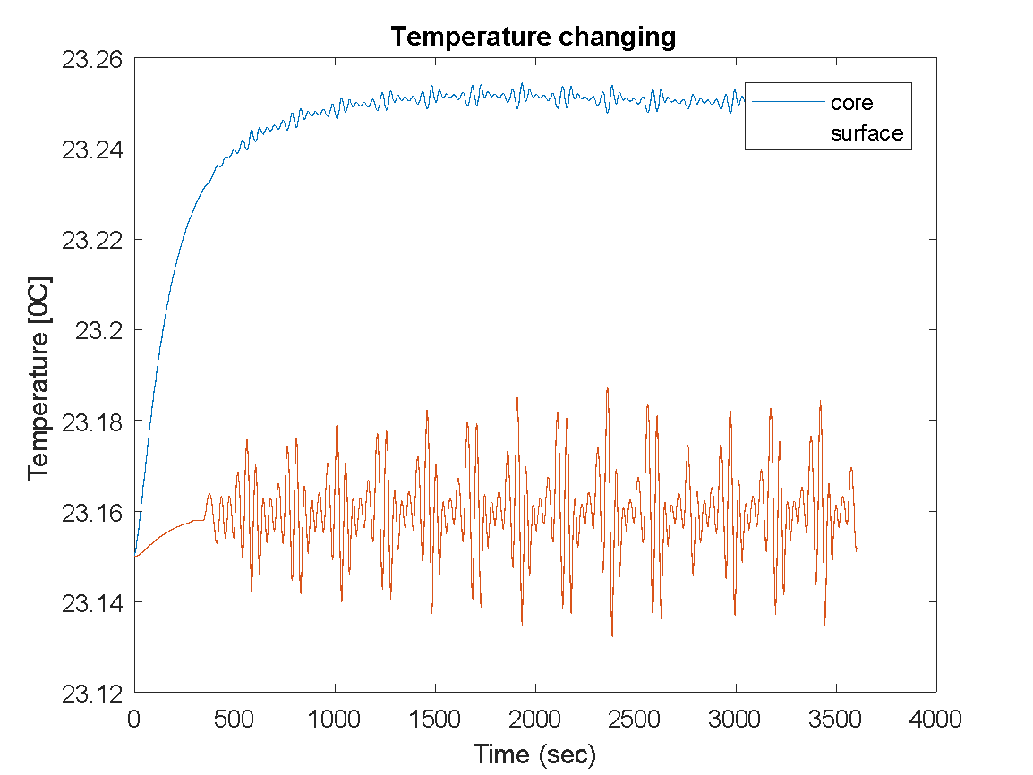
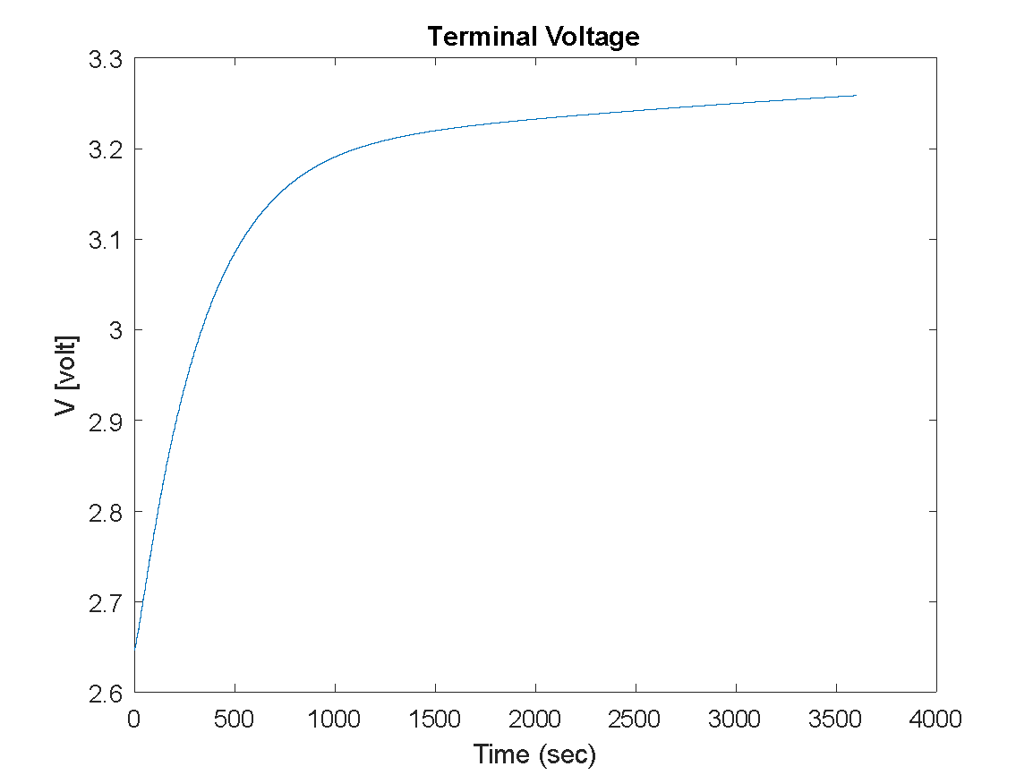
Simulation: Output
Notes:
For the simulation outputs, you can see SOC reached 50% after 1 hour. SOH decreased as the time go by.
The core and surface temperature of Li-ion battery also increased with time. The terminal voltage also increase as the SOC increases. Because the model is highly non-linear, there are some fluctuates for the output temperature .

Slide 15
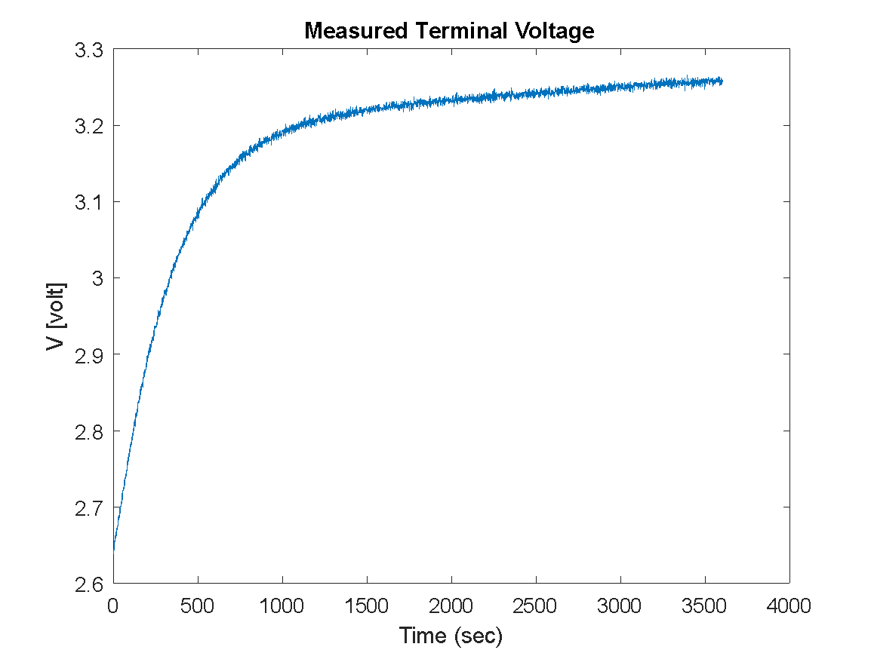

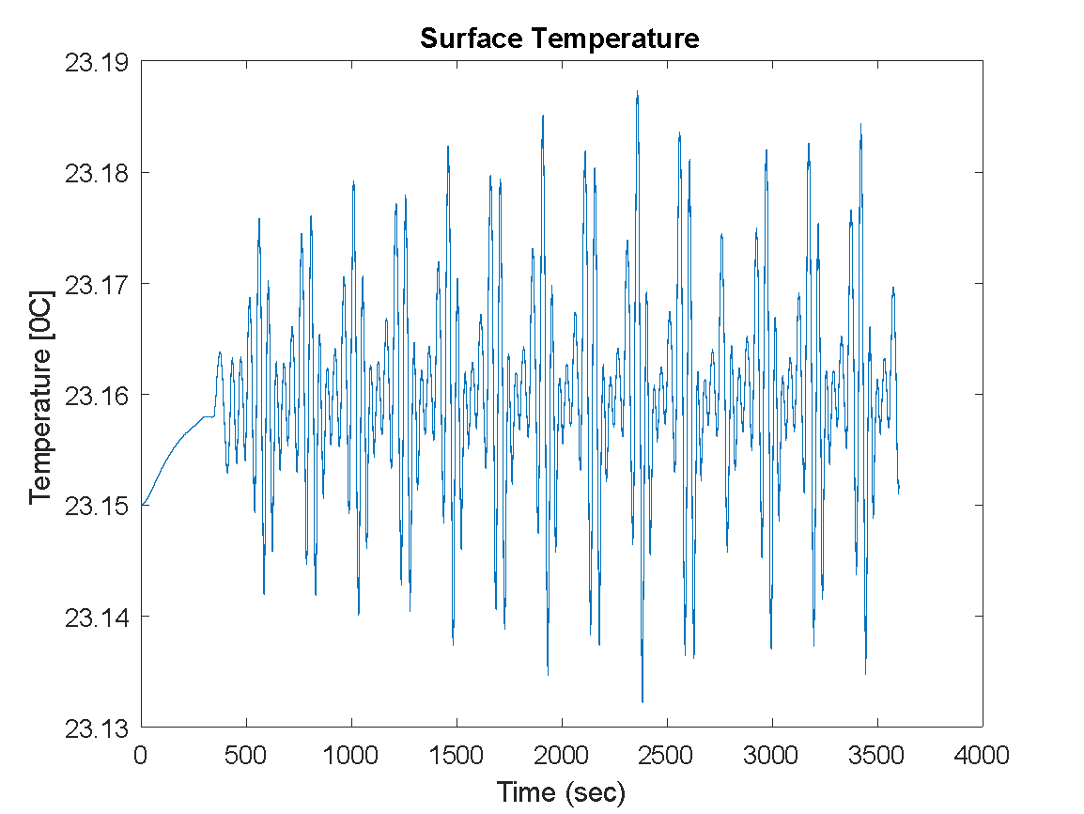
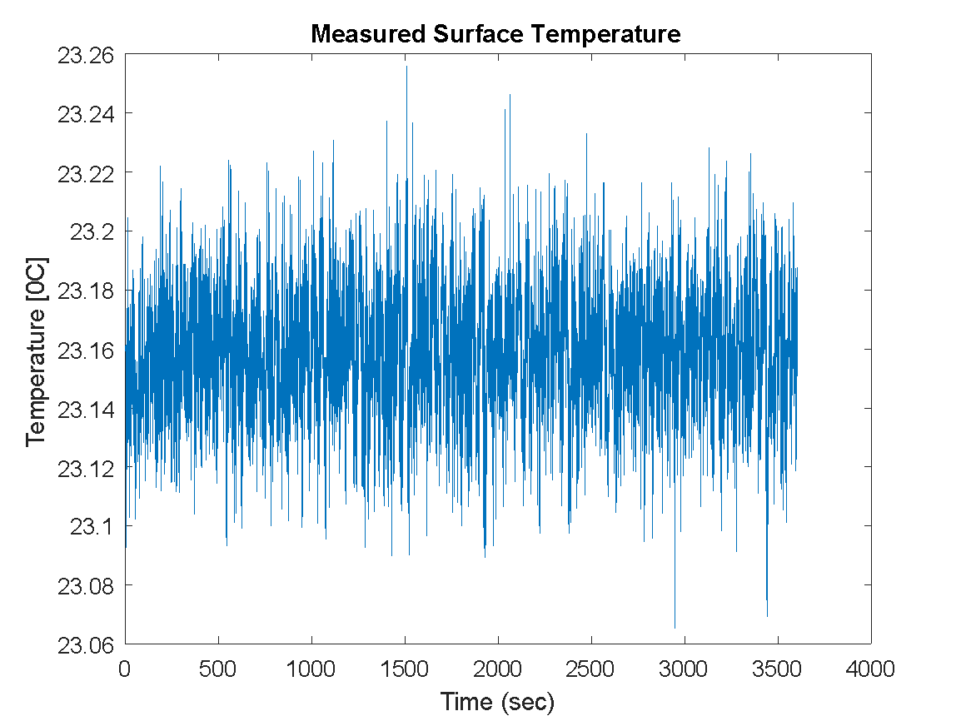
Simulation: Measured data
Notes:
We used the simulation values of Li-ion as the true data. Then, some noises were added in the data with SNR which is 60. We assume that measured data in experiment are same as to the data which contains noises.

Slide 16
State Estimation
Noise
Battery model
(Ground truth)
Measured data
Observer (EKF)
Estimated data
Comparison
Notes:
temperature observer and voltage observer

Slide 17
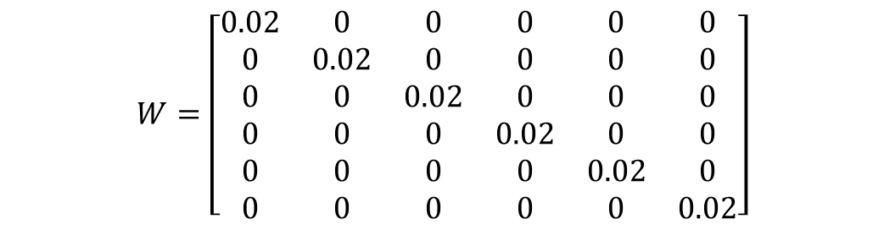


EKF Covariance Matrices
0

Slide 18
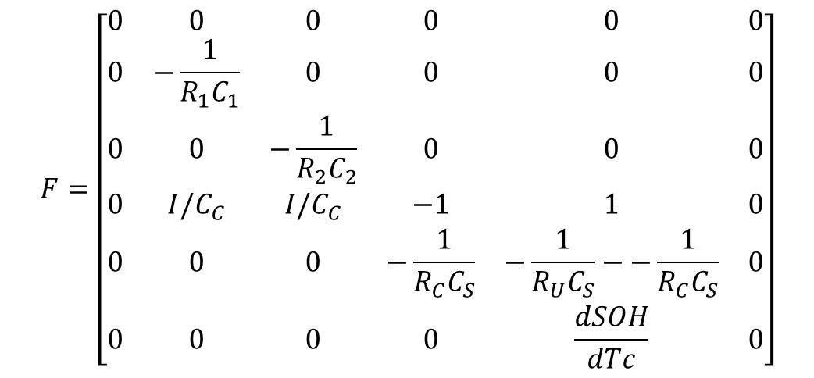
EKF Parameter for Temperature Observer

Slide 19
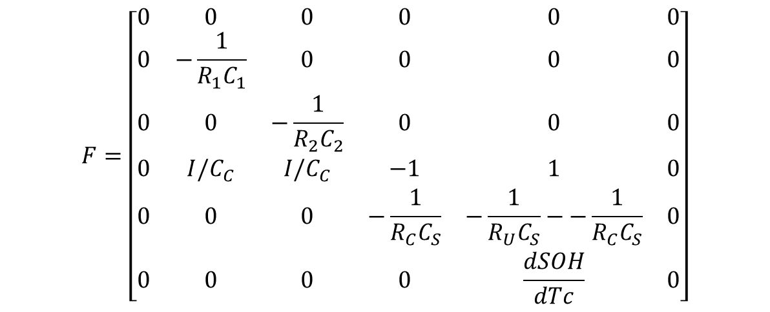
EKF Parameter for Voltage Observer

Slide 20
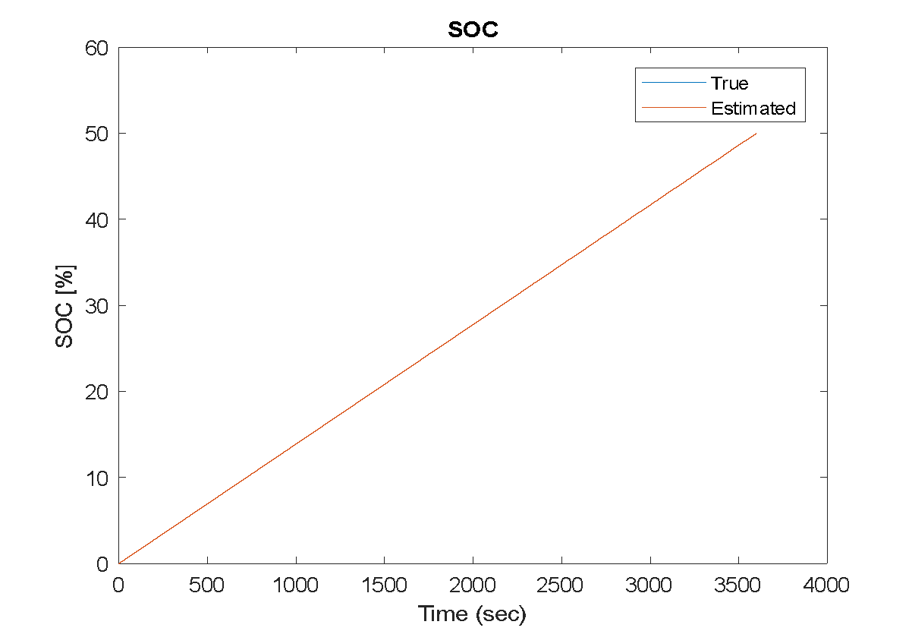
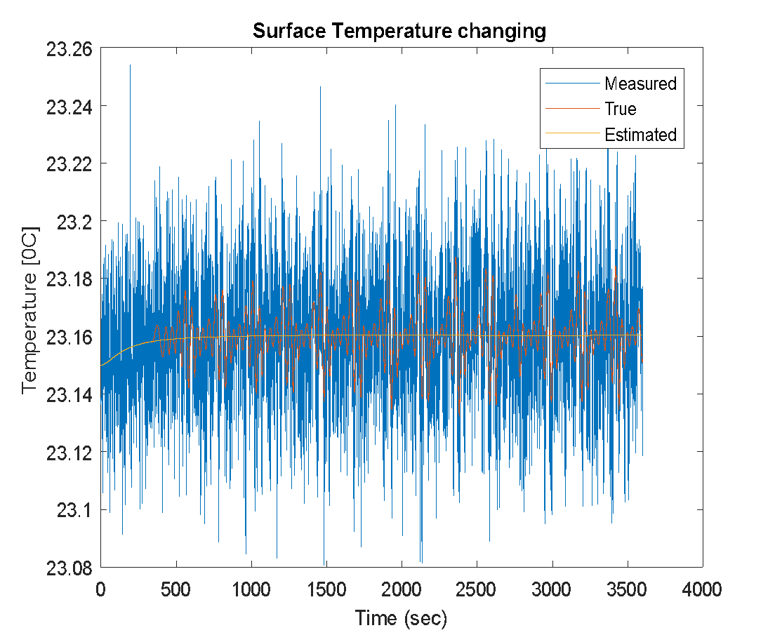
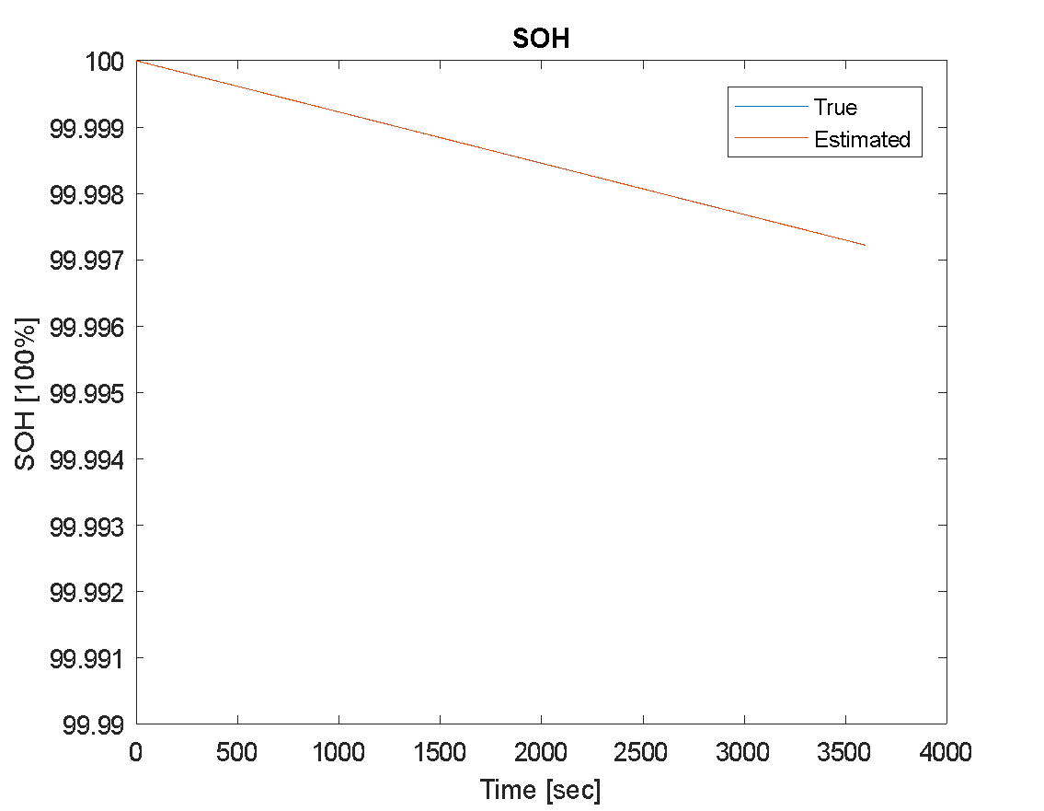
State Estimation Results: Temperature Observer

Slide 21
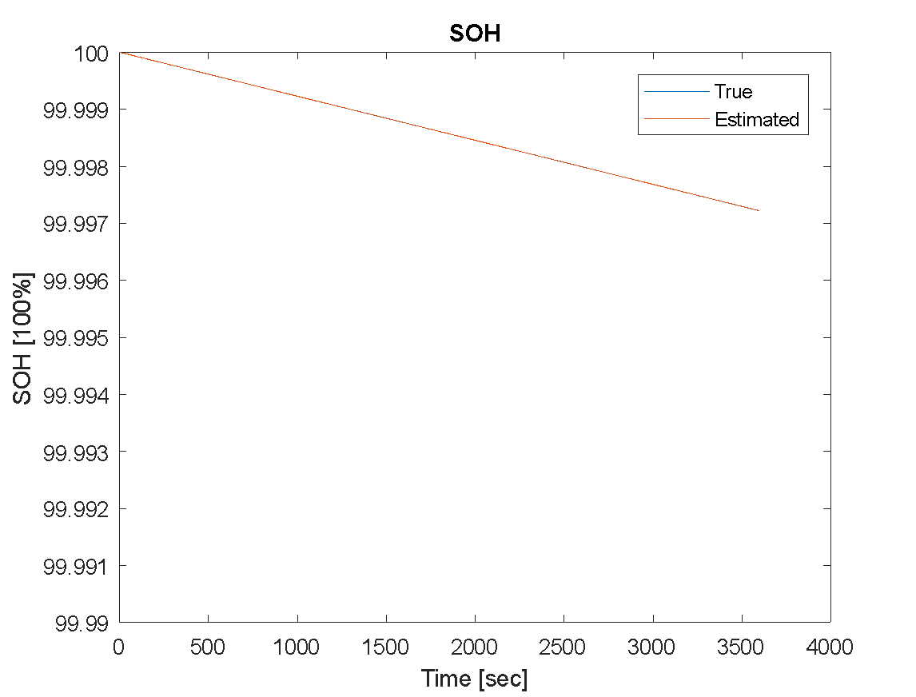
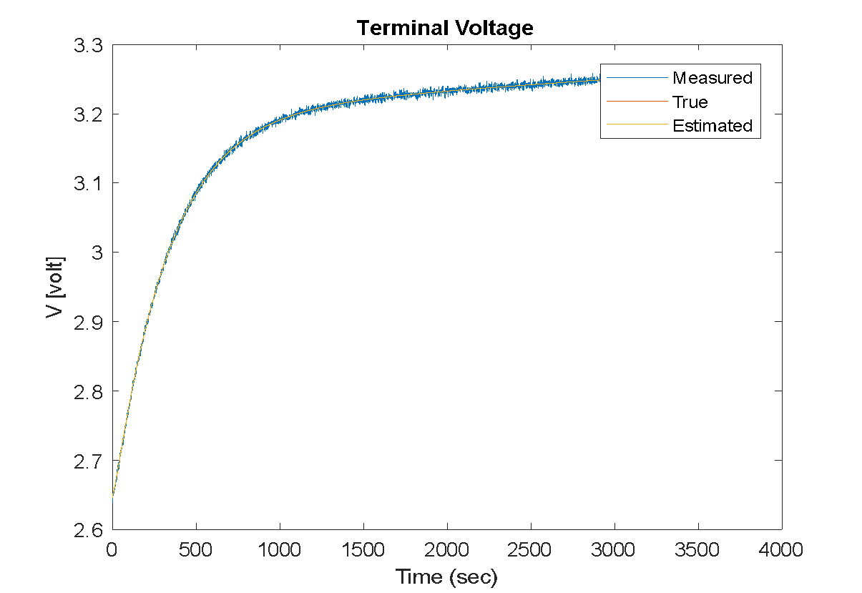
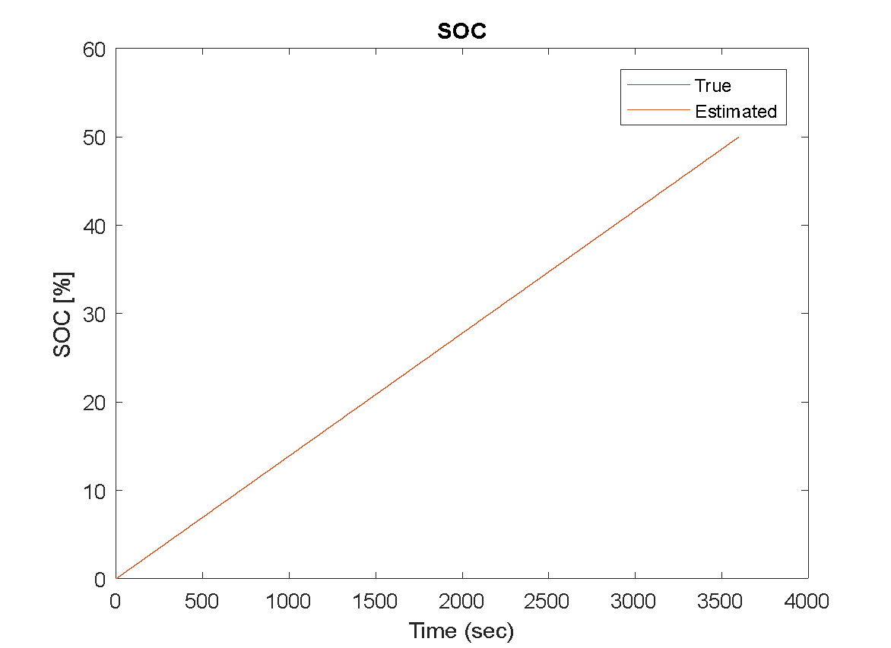
State Estimation Result: Voltage Observer

Slide 22
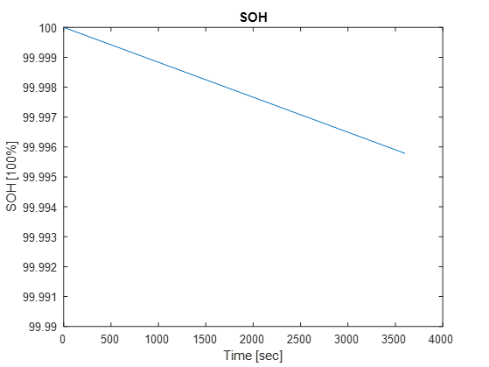
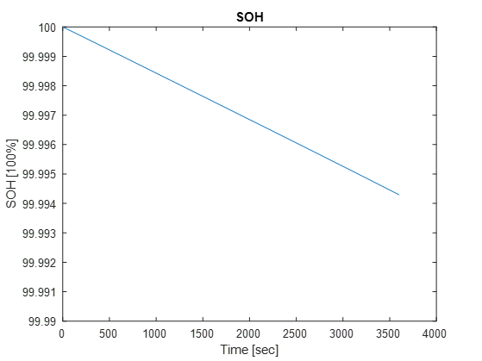
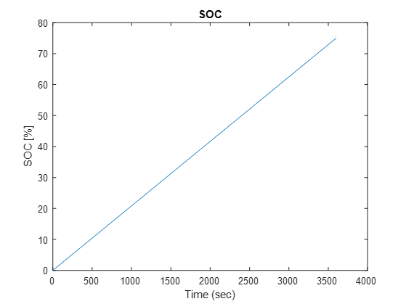
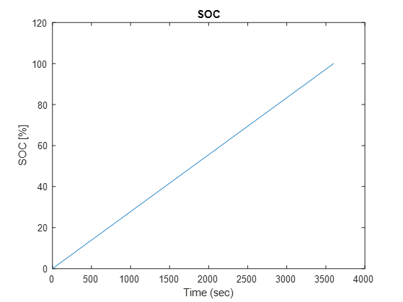
SOH & SOC for Different Input Current
Original
1.5X
2X

Slide 23
Discussion
Optimal Control for Battery Charging
Efficiency -- Minimum-time charge
Safety -- Minimum-aging charge
Balance -- Time and aging trade-off
(Doctor Perez’s work)

Slide 24
References
Perez, H. E., Siegel, J. B., Lin, X., Stefanopoulou, A. G., Ding, Y., & Castanier, M. P. (2012). Parameterization and Validation of an Integrated Electro-Thermal Cylindrical LFP Battery Model. ASME 2012 5th Annual Dynamic Systems and Control Conference joint with the JSME 2012 11th Motion and Vibration Conference (pp.41-50). American Society of Mechanical Engineers.
Perez, H. E., Hu, X., Dey, S., & Moura, S. J. (2017). Optimal charging of li-ion batteries with coupled electro-thermal-aging dynamics. IEEE Transactions on Vehicular Technology, 66(9), 7761-7770.
Jang, W., Chen, Z., Bao, W., Lau, C. N., & Dames, C. (2011). Cycle-life model for graphite-lifepo 4, cells. Journal of Power Sources, 196(8), 3942-3948.
Nitta, N., Wu, F., Lee, J. T., & Yushin, G. (2015). Li-ion battery materials: present and future. Materials Today, 18(5), 252-264.
Yilmaz, M., & Krein, P. T. (2013). Review of battery charger topologies, charging power levels, and infrastructure for plug-in electric and hybrid vehicles. IEEE Transactions on Power Electronics, 28(5), 2151-2169.

Slide 25
Thank you!
Q & A

